Slide 1
Strategic Expansion into EU Markets
Team: Emmanuel, Sai, Ravisha, Vivek
Spring 2025

Slide 2
Executive Summary
UK market saturation and high churn prompted EU expansion.
Target: Netherlands, Ireland, Germany.
Approach: Data-driven roadmap with analytics, governance, design.
Expected ROI: 400% by year three.

Slide 3
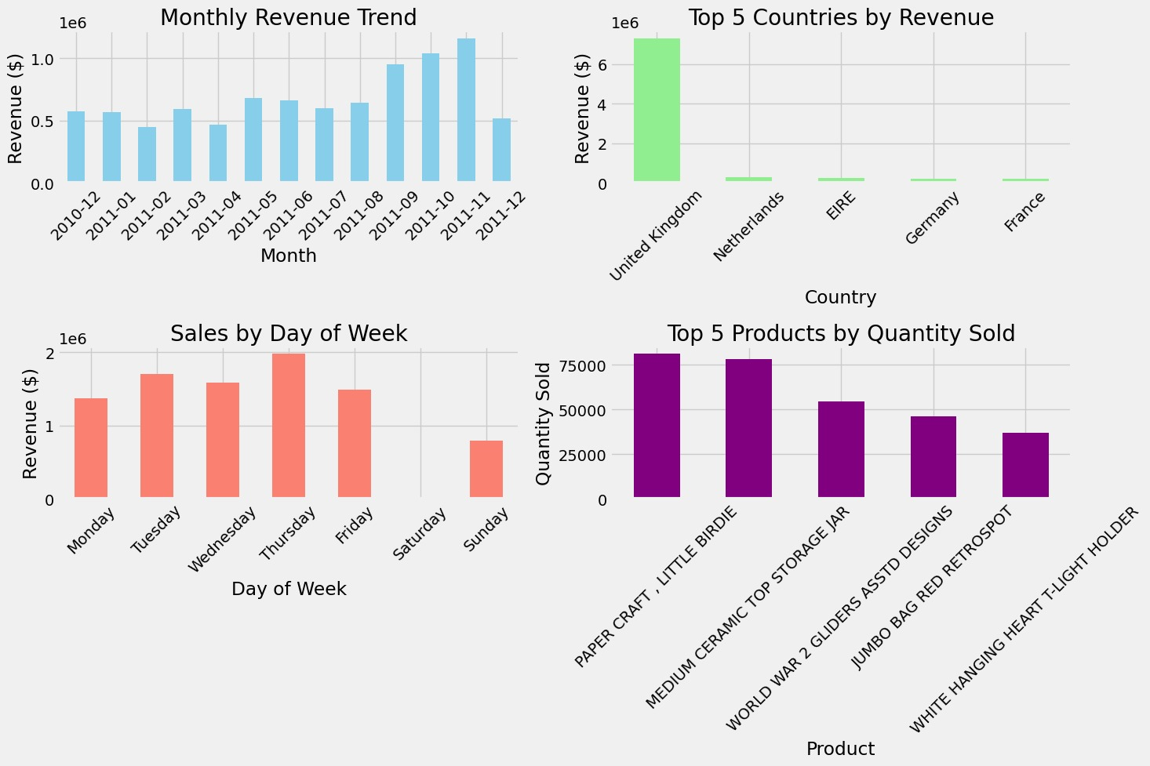
Business Problem
82% of revenue from UK; repeat purchase rate declining (57% churn).
Strategic need to diversify and stabilize revenue base.

Slide 4
Data Overview & Insights
Total sales: $8.9M, 500,000+ transactions.
RFM analysis shows high churn, low repeat activity.
Netherlands: highest basket size; Ireland: high loyalty; Germany: eco-focus.

Slide 5
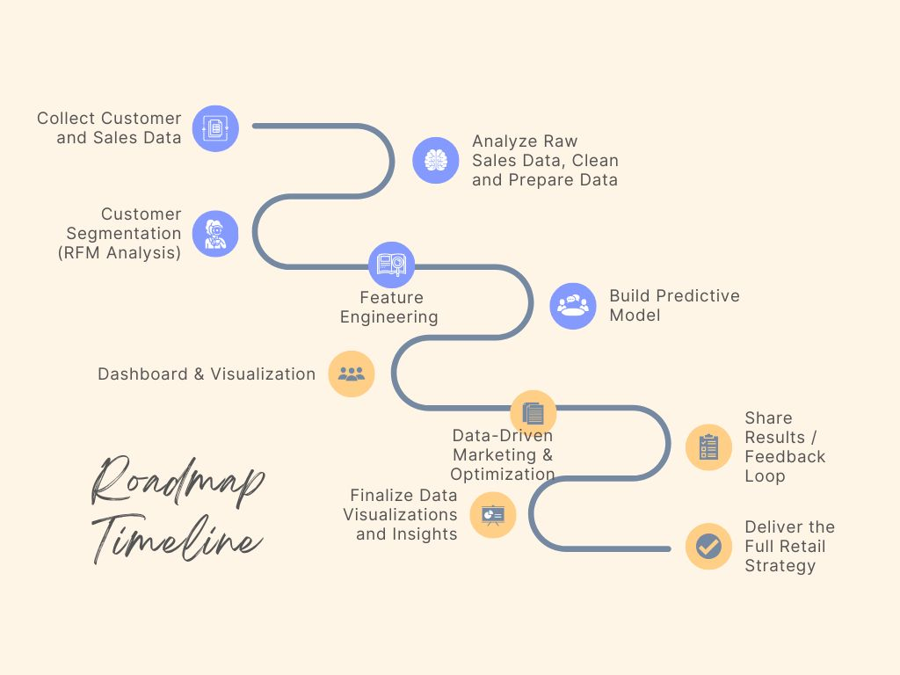
Strategy Framework
Vision: Predictive, customer-first retail.
Mission: Data-driven expansion and retention.
Approach: Localized strategy using BI, predictive analytics, regional design.

Slide 6
Business Model Canvas
Segments: B2B, lifestyle, eco-focused.
Value: Quality British products, local support.
Channels: Regional sites, marketplaces, mobile.
Activities: Localization, fulfillment, marketing.

Slide 7
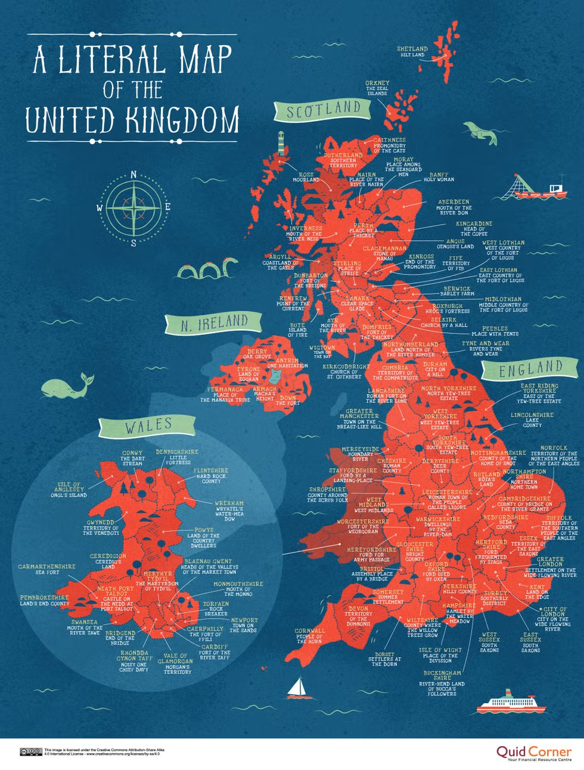
Competitive Landscape
Netherlands: Bol.com, Coolblue.
Ireland: Amazon UK, Littlewoods.
Germany: Otto, Zalando.
Differentiation: B2B focus, product uniqueness, localized CX.

Slide 8
Balanced Scorecard + OKRs
Financial: 150% EU revenue growth, 15% margin.
Customer: 85% CSAT, <30% cart abandonment.
Process: <3-day delivery, 98% accuracy.
Growth: Local staff onboarding, partnerships.

Slide 9

Customer Personas
Beatrix (NL): B2B wholesale buyer.
Liam (IE): Lifestyle shopper.
Klara (DE): Eco-conscious buyer.
Needs: Speed, curation, sustainability.

Slide 10
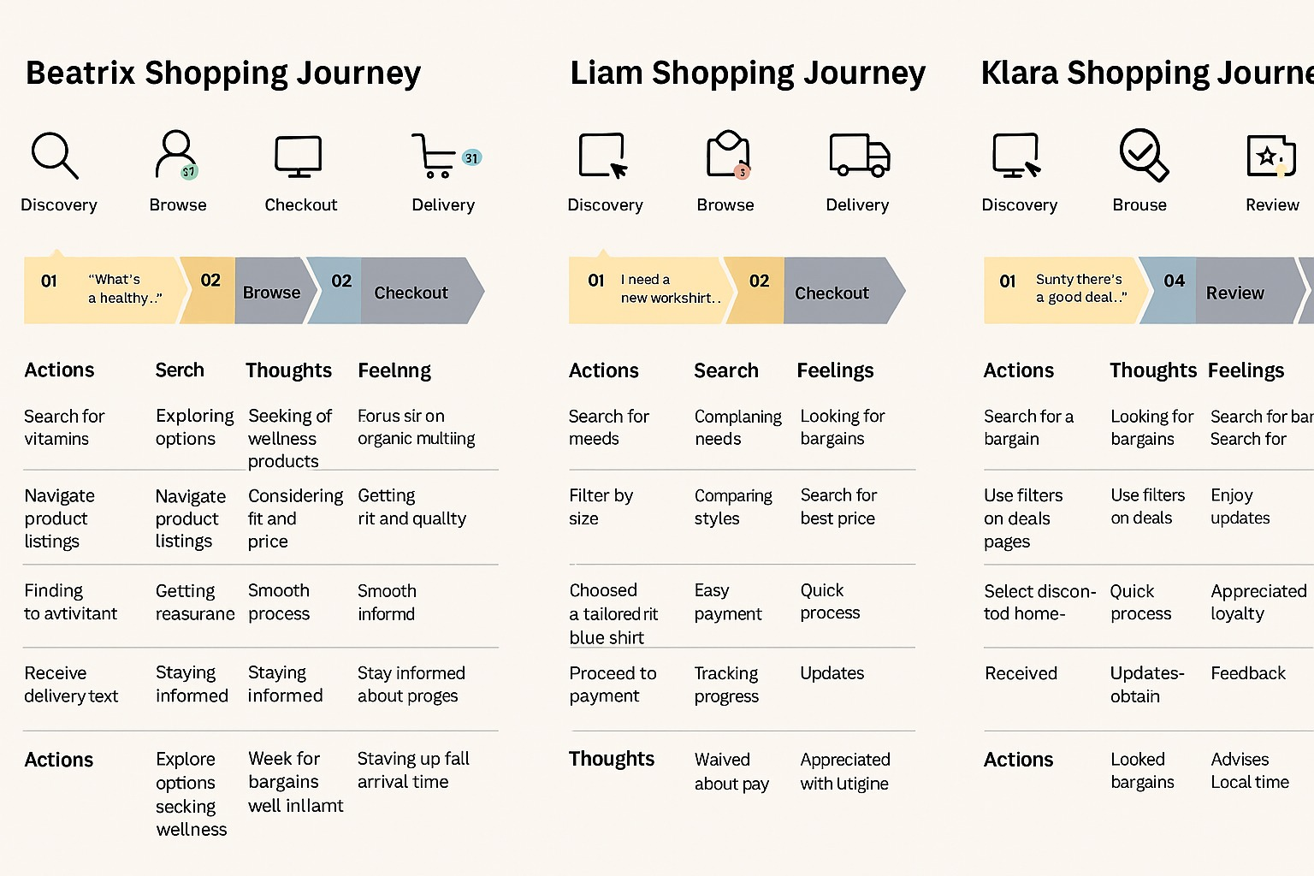
Customer Journey Maps
Stages: Awareness → Research → Decision → Delivery → Loyalty.
Pain points: Delivery, support, returns.
Emotion metrics mapped for all personas.

Slide 11

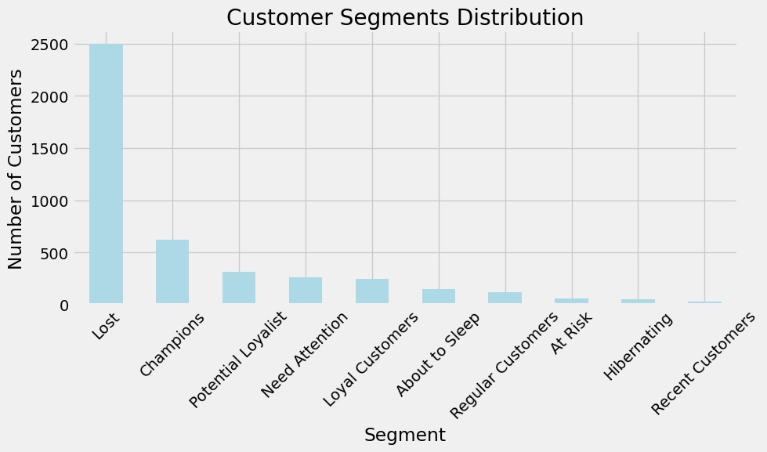
Analytics Use Case: Predicting Churn
Model: Logistic regression.
Features: Recency, frequency, monetary, basket size.
Action: Personalized offers, loyalty triggers.

Slide 12
Dimensional Model
Fact tables: Sales, Customer Activity, Shipping.
Dimensions: Product, Customer, Geography, Date, Promotion.
Supports segmentation, market KPIs.

Slide 13
Governance & Glossary
Field tags: PII, Compliance, Marketing, KPI.
Glossary: AOV, CLTV, Churn, Market Tier.
Ensures data trust and alignment.

Slide 14
Power BI Dashboard Insights
Visuals: Basket size by market, churn segments, monthly sales trends.
Demo: pbix file with regional filters.
Impact: Guides strategy, tracks expansion success.

Slide 15
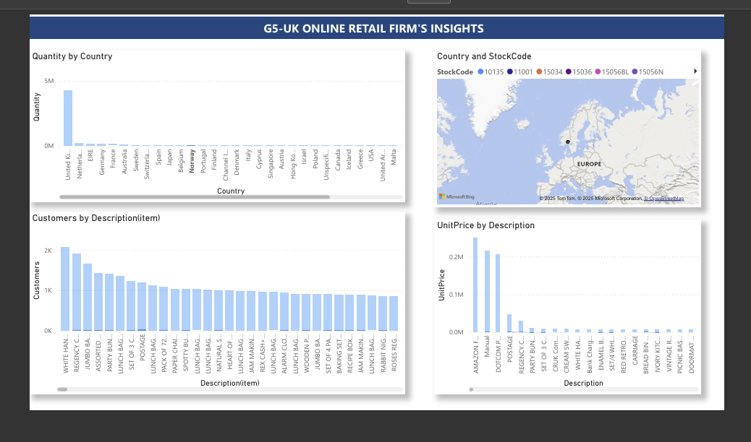
Power BI Dashboard
Power BI Dashboard Insights

Slide 16
Expansion Roadmap & Recommendations
Phase 1: Netherlands site, EU hub, targeted ads (Q2).
Phase 2: Ireland CX, payment localization (Q3).
Phase 3: Germany launch, sustainability focus (Q4).
Add: Regional loyalty, reactivation for 'Lost' segment.

Slide 17

Lessons Learned & Challenges
Data cleanup complexity.
Analytics clarified decisions.
Design thinking aligned strategy.
Dashboards improved executive buy-in.

Slide 18
Ethical Considerations
Challenges: Data bias, targeting vulnerability, privacy concerns, misclassification, over-segmentation.
Approach: Establish ethical guidelines, monitor model performance, and review outcomes regularly.

Slide 19

Process Flow Diagram
Cross-market flow:
- Localized web access
- Logistics
- Customer support
- Loyalty programs.
Ensures smooth operations across Netherlands, Ireland, Germany.

Slide 20
Predictive Model Plan
Model: Logistic Regression.
Label: Churn (no purchase in 6 months).
Features: Recency, Frequency, Monetary, Basket Size.
Outcome: Identify at-risk customers and trigger interventions.

Slide 21
Governance Model
Data Dictionary: Lists all tables and fields.
Tags: PII, KPI, compliance, segmentation.
Business Glossary: AOV, Basket Size, Churn, CLTV, Conversion Rate, Cart Abandonment, Product Fit Score, Market Tier.

Slide 22
Key Recommendations
Prioritize
Prioritize Netherlands B2B focus.
Establish
Establish EU operations hub for logistics.
Develop
Develop region-specific product curation.
Launch
Launch local loyalty/rewards programs.
Monitor
Monitor country-specific dashboards and metrics.

Slide 23

Appendix & Resources
Includes: UCI dataset link, segment charts, basket size visuals, personas, journey maps, PBIX file demo screenshots.
Serves as reference for detailed analytics and design outputs.

